Slide 1
Kaggle Competition
Titanic: Machine Learning from Disaster in R
Kapil Bastola
02/22/2017

Slide 2
Content
Introduction
  Background
  Topic
  Usage of Package
Data
Method
Evaluation
Prediction
Summary

Slide 3
Background
Titanic sank in 1915 when it collided with an iceberg
Killed 1502 out of 2224 passengers in the ship
Dataset consists of information regarding passengers in the ship

Slide 4

Topic

Slide 5
Usage of package
Packages used are
  rpart for decision trees
  randomForest for Random Forest
  e1071 for Support Vector Machines
  rattle and rpart.plot for visualizing decision trees
  ROCR for area under the ROC curve
  SDMTools for calculating confusion.matrix

Slide 6
Data
There are two group of datasets, the train set and the test set.
Outcome (survived) is provided for the train set
The outcome of test set is given in another

Slide 7
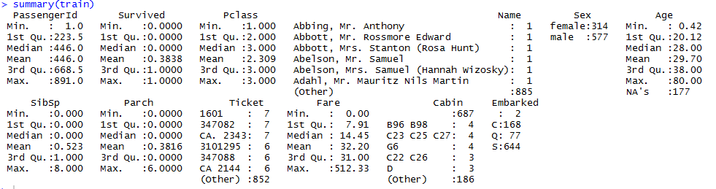
Data
Train Dataset consists of 12 columns and test dataset consists of 11 columns with Survived column missing
Below is the summary of the train dataset

Slide 8
Method
Since we have labels for our dataset we will use supervised learning algorithms to predict the outcomes.
For the study I have decided to use Decision Trees, Random Forest, and Support Vector Machines to predict outcomes
The predicted outcomes will be cross validated with the test set and I will compare the performance of these models using precision, recall, and FMeasure

Slide 9

Method
Decision Tree
  Created a fit using rpart package
  Used Survived as the outcome variable and other numerical and categorial variables as classes
  Predicted the outcome of test dataset using predict function
  Calculated the confusion matrix and performance of the model

Slide 10
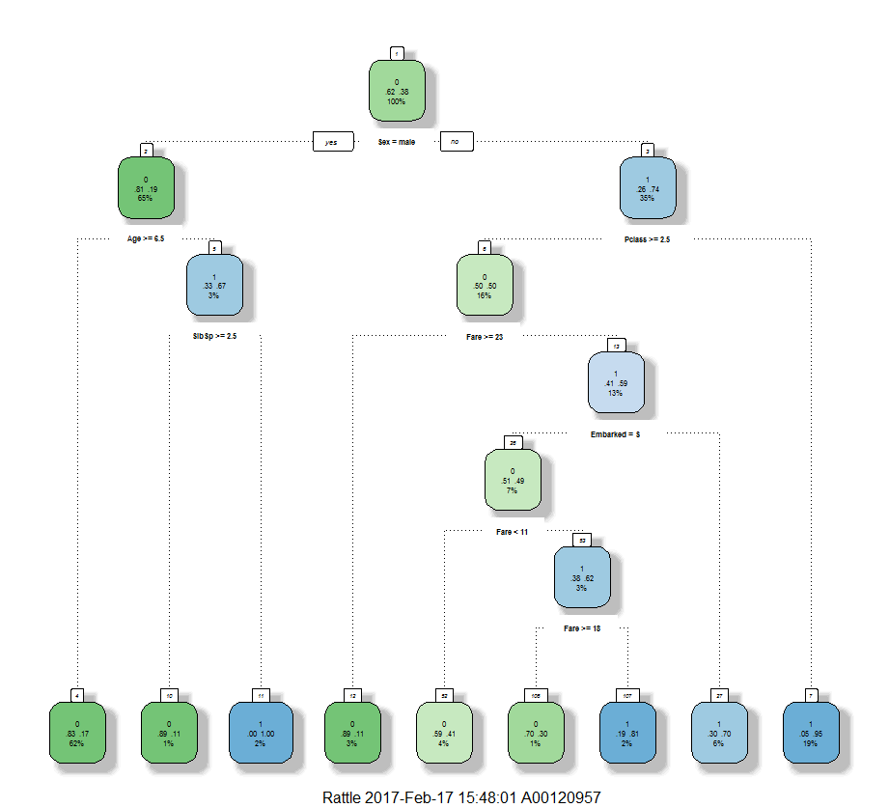

Slide 11
Random Forest

Slide 12
Support Vector Machine

